Slide 1
Struts 2.0

Slide 2
Introduction
The struts 2 framework is used to develop MVC-based web application.
The struts framework was initially created by Craig McClanahan and donated to Apache Foundation in May, 2000 and Struts 1.0 was released in June 2001.
The current stable release of Struts is Struts 2.3.16.1 in March 2, 2014.

Slide 3
Features of Struts
Configurable MVC components
POJO based actions
AJAX support
Integration support
Various Result Types
Various Tag support
Theme and Template support

Slide 4
1) Configurable MVC components
  In struts 2 framework, we provide all the components (view components and action) information in struts.xml file. If we need to change any information, we can simply change it in the xml file.
2) POJO based actions
  In struts 2, action class is POJO (Plain Old Java Object) i.e. a simple java class. Here, you are not forced to implement any interface or inherit any class.

Slide 5
3) AJAX support
  Struts 2 provides support to ajax technology.
  It is used to make asynchronous request i.e. it doesn't block the user. It sends only required field data to the server side not all. So it makes the performance fast.
4) Integration Support
  We can simply integrate the struts 2 application with hibernate, spring, tiles etc. frameworks.
5) Various Result Types
  We can use JSP, freemarker, velocity etc. technologies as the result in struts 2.

Slide 6
6) Various Tag support
  Struts 2 provides various types of tags such as UI tags, Data tags, control tags etc to ease the development of struts 2 application.
7) Theme and Template support
  Struts 2 provides three types of theme support: xhtml, simple and css_xhtml.
  The xhtml is default theme of struts 2. Themes and templates can be used for common look and feel.

Slide 7
From a high level, Struts2 is a pull-MVC (or MVC2) framework.
The Model-ViewController pattern in Struts2 is implemented with the following five core components −
        Actions
        Interceptors
        Value Stack / OGNL
        Results / Result types
        View technologies
Struts 2 is slightly different from a traditional MVC framework, where the action takes the role of the model rather than the controller, although there is some overlap.

Slide 8
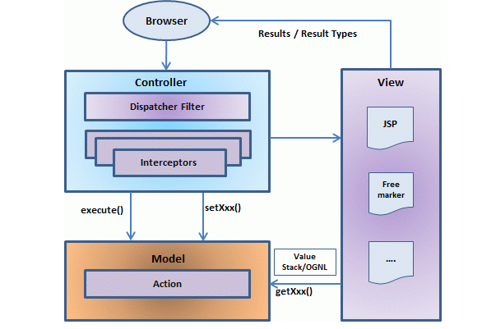

The controller is implemented with a Struts2 dispatch servlet filter as well as interceptors, this model is implemented with actions, and the view is a combination of result types and results.
The value stack and OGNL provides common thread, linking and enabling integration between the other components.
Apart from the above components, there will be a lot of information that relates to configuration.
Configuration for the web application, as well as configuration for actions, interceptors, results, etc.
This is the architectural overview of the Struts 2 MVC pattern.
User sends a request to the server for requesting for some resource (i.e. pages).
The Filter Dispatcher looks at the request and then determines the appropriate Action.
Configured interceptor functionalities applies such as validation, file upload etc.
Selected action is performed based on the requested operation.
Again, configured interceptors are applied to do any post-processing if required.
Finally, the result is prepared by the view and returns the result to the user

Slide 9
Request Life cycle
User sends a request to the server for requesting for some resource (i.e. pages).
The Filter Dispatcher looks at the request and then determines the appropriate Action.
Configured interceptor functionalities applies such as validation, file upload etc.
Selected action is performed based on the requested operation.
Again, configured interceptors are applied to do any post-processing if required.
Finally, the result is prepared by the view and returns the result to the user.

